Slide 1
真空腔體系統的設計、控制與操作

Slide 2
真空系統的建置，須考量如下
主要思考項目
次要思考項目
適切的真空法蘭面
合適的真空計的選用
適切的真空幫浦的選用
適切閥門選用
材料選用
腔體大小形狀
溫度
氣 電 引入
安全
容易安裝 容易維修 容易操作
操控系統
紀錄
真空壓力範圍
製程方式
抽氣方式
成本
操作及日後維護方便
以上主要＆次要項目 相戶影響 、牽制 才有結論

Slide 3
真空系統含那些主要項目及操作方式
真空項目
操作方式
Vacuum Chamber
Vacuum Pump
Vacuum Gauges
Vacuum Valves
真空引入(氣,電…),
Sensor( Diode sensor,….)
機械手臂
Heater
Vacuum 元件( 視窗, Bellow,adapter…)
完全目視/完全手動
完全目視/完全手動( 感應防呆)
完全目視/部分手動,部分自動 (感應防呆)
高程度自動化行程

Slide 4
Chamber
大小
形體
強度
使用的真空壓力
溫度
腐蝕性?
引入
機械傳輸 轉動
未來 PM
圓柱/方形
壓力產生的形變( 1kg/cm2) & 腔們強度 , 載重( Valve, Pump......)
304, 316, 304ESR, 鋁合金......
O-RING/All Metal
冷卻水 gas 電
robot

Slide 5
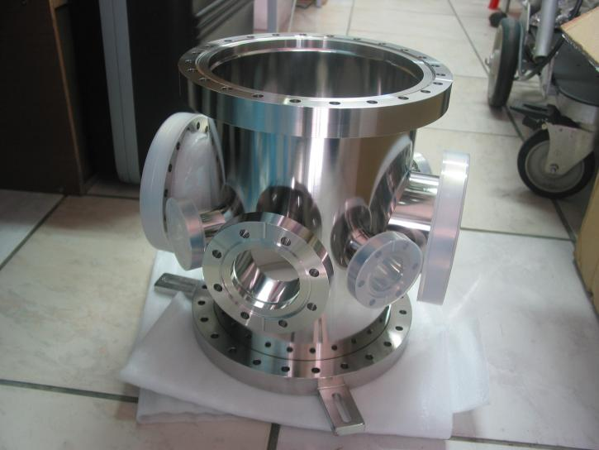
Chamber
Flanges 多寡, Size, Oring or All metal ( CFF, ISO, KF, ANSI?)
Viewport?
Turbo pump/Cryo pump 採 橫掛或垂直
震動考量
feedthrough

Slide 6
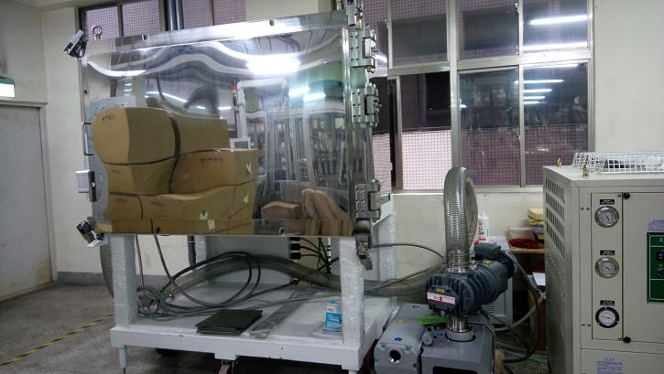
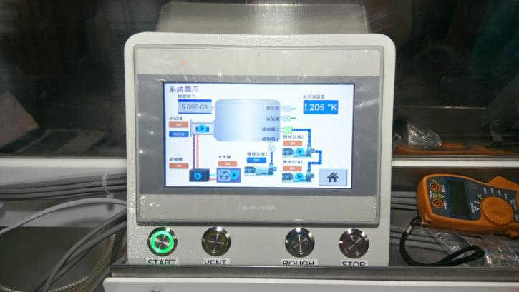
本公司及母公司的相關範例

Slide 7
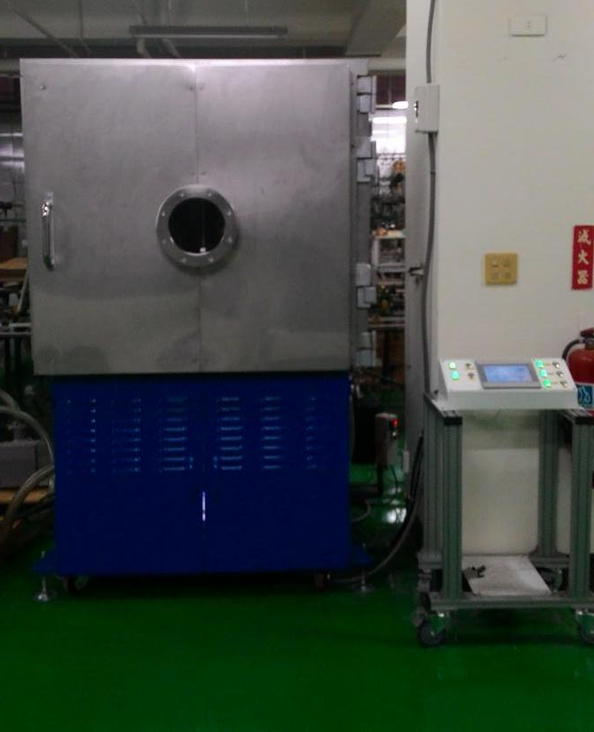
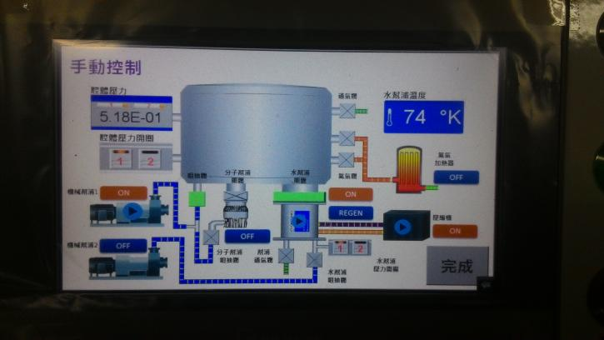
本公司及母公司的相關範例

Slide 8
Vacuum Levels
Torr
Pa
miles (km)
10⁻¹²
10⁻¹⁰
Altitude
Pressure
Ultra-High
Vacuum
1000 (1609)
10⁻¹⁰
10⁻⁸
Typical
Base
Pressures
{
400 (644)
}
10⁻⁸
10⁻⁶
Space Shuttle
}
200 (322)
High
Vacuum
{
10⁻⁶
10⁻⁴
100 (161)
Low-Earth
Satellites
Process
Pressures
10⁻⁴
10⁻²
80 (129)
60 (97)
10⁻²
1
Rough
Vacuum
40 (64)
1
100
}
20 (32)
Aircraft
100
10⁴
}
Cirrus Clouds
760
10⁵
0 Sea Level
Notes:
Notes:
__________________________________________________________________________________________________________________________________________________________________________________________________________________________________________________________________________________________________________________________________________________________________________________________________________________________________________________________________________________________________________________________________________________________________________________________________________________________________________________________________________________________________________________________________________________________________________________________________________________________________________________________________________________________________________________

Slide 9
Vacuum Pumps
Pumping System Ranges
Ultra-High Vacuum
High Vacuum
Rough Vacuum
Ion Pump/TSP PUMP
Mechanical
Turbomolecular backed with 2 Stage Mechanical Pump
Dry Scroll pump
Oil Diffusion Pump with Cold Trap
Cryopump
Waterpump
10⁻¹⁰ 10⁻⁹ 10⁻⁸ 10⁻⁷ 10⁻⁶ 10⁻⁵ 10⁻⁴ 10⁻³ 10⁻² 760
Pressure (Torr)
Notes:
Notes:
__________________________________________________________________________________________________________________________________________________________________________________________________________________________________________________________________________________________________________________________________________________________________________________________________________________________________________________________________________________________________________________________________________________________________________________________________________________________________________________________________________________________________________________________________________________________________________________________________________________________________________________________________________________________________________________

Slide 10
如何選擇幫浦
(超)高真空幫浦
Primary Pump
Turbo Pump
Diffusion Pump
Ion Pump/TSP/NEG
Cryo Pump
複合幫浦
Pumping Speed ( 在不同壓力下的 抽氣速度)
Oil or Dry
腐蝕程度 粉塵程度
N2 Purge( 同上 或 氣爆)
節電

Slide 11
CRYOPUMPING BASICS:
Operation - Cryoadsorption
Air gases and water vapor still condensed - noncondensible gases captured.
<20 K
80 K
H₂O
N₂
Ar
H₂
Ne
He
2nd Stage
1st Stage
Notes:
Notes:
__________________________________________________________________________________________________________________________________________________________________________________________________________________________________________________________________________________________________________________________________________________________________________________________________________________________________________________________________________________________________________________________________________________________________________________________________________________________________________________________________________________

Slide 12
GAS LOAD and Pump througtput
Another name for Q, the throughput, is gas load. Where does gas load, “Q” come from?
Permeation
Outgassing
Real
Q pump>Q gas load total
Leaks
Diffusion
Virtual
Pressure goes down
Backstreaming
(Don’t forget Volume gas!)
Pump Q(throughput)

Slide 13
選擇Valves
Gate Valve
Butterfly Valve
Roughing Valves( inline/right angle)
Needle valve
Ball valve
進氣閥
微漏閥
others
不同的閥門有其功能性 , 其中需考量：真空度、氣導、逸氣、開關次數、洩漏率、價錢 ......等。

Slide 14
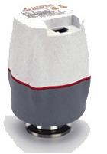
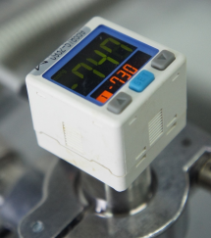
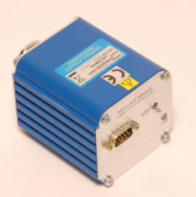
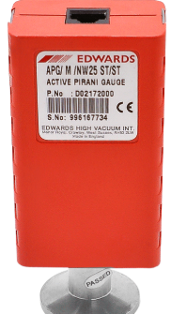
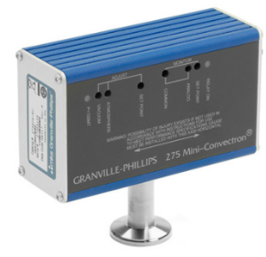
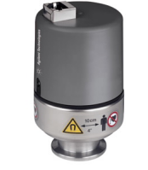
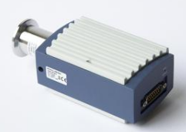
選擇真空計

Slide 15
Types of Vacuum Gauges
Direct Gauges (Displacement of a wall)
Solid Wall
Liquid Wall
Diaphragm
Bourdon Type
Capacitance Diaphragm
McLeod
U-Tube Manometer

Slide 16
Types of Vacuum Gauges (cont.)
Indirect Gauges
(Measurement of a gas property)
Charge Generation
(Ionization)
Energy Transfer
(Heat Loss)
Momentum Transfer
(Viscosity)
Thermocouple
Pirani
CONVECTRON®
Spinning Rotor
Cold Cathode
Hot Cathode
Penning
Inverted Magnetron
Triode
Schulz-Phelps
Bayard-Alpert
STABIL-ION®

Slide 17
Ranges of Vacuum Gauges
Bourdon
Diaphragm
U-Tube Manometer
McLeod
Capacitance Diaphragm
Thermocouple
Pirani
CONVECTRON®
Spinning Rotor
Cold Cathode
Schulz-Phelps
Triode
Tubulated Bayard-Alpert
STABIL-ION®
Nude Bayard-Alpert
10⁻¹²
10⁻¹¹
10⁻¹⁰
10⁻⁹
10⁻⁸
10⁻⁷
10⁻⁶
10⁻⁵
10⁻⁴
10⁻³
10⁻²
10⁻¹
1
10
100
1000
Pressure (Torr)

Slide 18
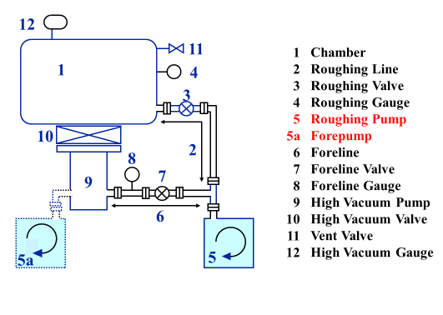
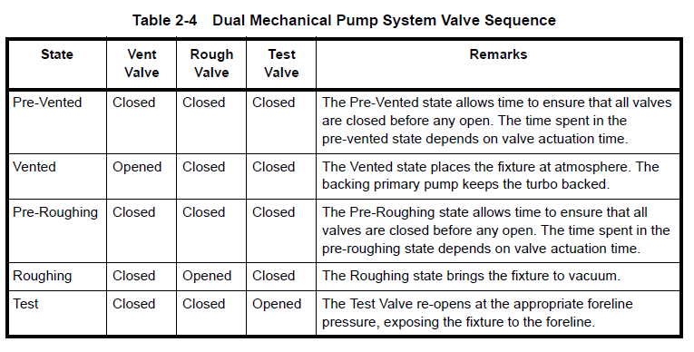
決定真空行程

Slide 19
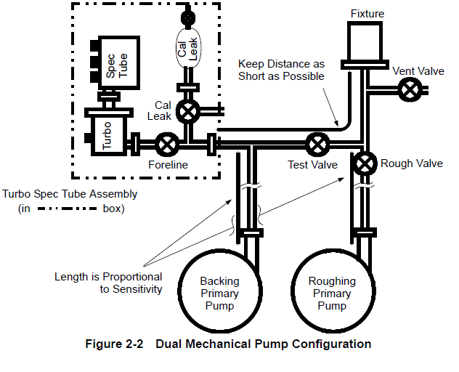
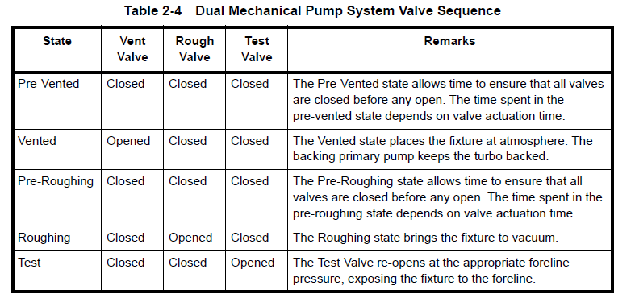
範例一簡單版 :Leak Detectors Valves Logistics

Slide 20
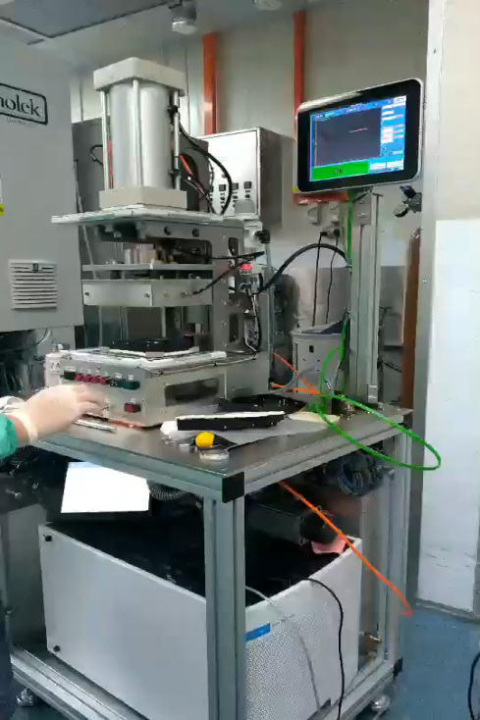
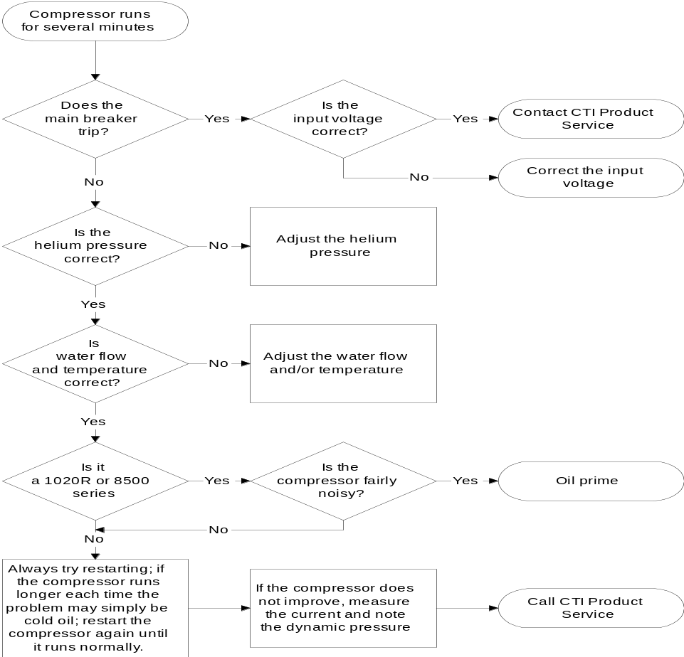
範例二複雜版
(母公司範例)

Slide 21
CTI-CRYOGENICS
Compressor won’t run
Notes:
Red = return pressure helium
Green = supply pressure helium
Blue = cooling water Note the the system is sensitive to water flow direction, as well as rate and temperature.
Yellow = oil flow

Slide 22
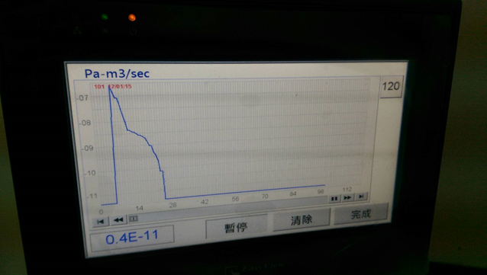
紀錄
日期 | 時間 | 毫秒 | Eq ID | S/N | Op ID | Test Result | Leak Rate | Leak Trend
2018/6/13 | 9:22:22 | 240 | 0 | 0 | 0 | 2 | 0.7E-09 | -8.93
2018/6/13 | 9:22:23 | 540 | 0 | 0 | 0 | 2 | 0.7E-09 | -8.929
2018/6/13 | 9:22:24 | 210 | 0 | 0 | 0 | 2 | 0.7E-09 | -8.928
2018/6/13 | 9:22:25 | 310 | 0 | 0 | 0 | 2 | 0.7E-09 | -8.926
2018/6/13 | 9:22:26 | 280 | 0 | 0 | 0 | 2 | 0.8E-09 | -8.92
2018/6/13 | 9:22:27 | 270 | 0 | 0 | 0 | 2 | 0.1E-09 | -8.99
2018/6/13 | 9:22:28 | 230 | 0 | 0 | 0 | 2 | 0.0E-09 | -8.999
2018/6/13 | 9:22:29 | 220 | 0 | 0 | 0 | 2 | 0.0E-09 | -8.999
2018/6/13 | 9:22:30 | 320 | 0 | 0 | 0 | 2 | 0.0E-09 | -8.999
2018/6/13 | 9:22:31 | 300 | 0 | 0 | 0 | 2 | 0.0E-09 | -8.999
2018/6/13 | 9:22:32 | 270 | 0 | 0 | 0 | 2 | 0.0E-09 | -8.999
2018/6/13 | 9:22:33 | 250 | 0 | 0 | 0 | 2 | 0.0E-09 | -8.999
2018/6/13 | 9:22:34 | 220 | 0 | 0 | 0 | 2 | 0.0E-09 | -8.999
2018/6/13 | 9:22:35 | 320 | 0 | 0 | 0 | 2 | 0.0E-09 | -8.999
2018/6/13 | 9:22:36 | 300 | 0 | 0 | 0 | 2 | 0.0E-09 | -8.999
2018/6/13 | 9:22:37 | 290 | 0 | 0 | 0 | 2 | 0.0E-09 | -8.999
2018/6/13 | 9:22:38 | 270 | 0 | 0 | 0 | 2 | 0.0E-09 | -8.999
2018/6/13 | 9:22:39 | 240 | 0 | 0 | 0 | 2 | 0.0E-09 | -8.999

Slide 23
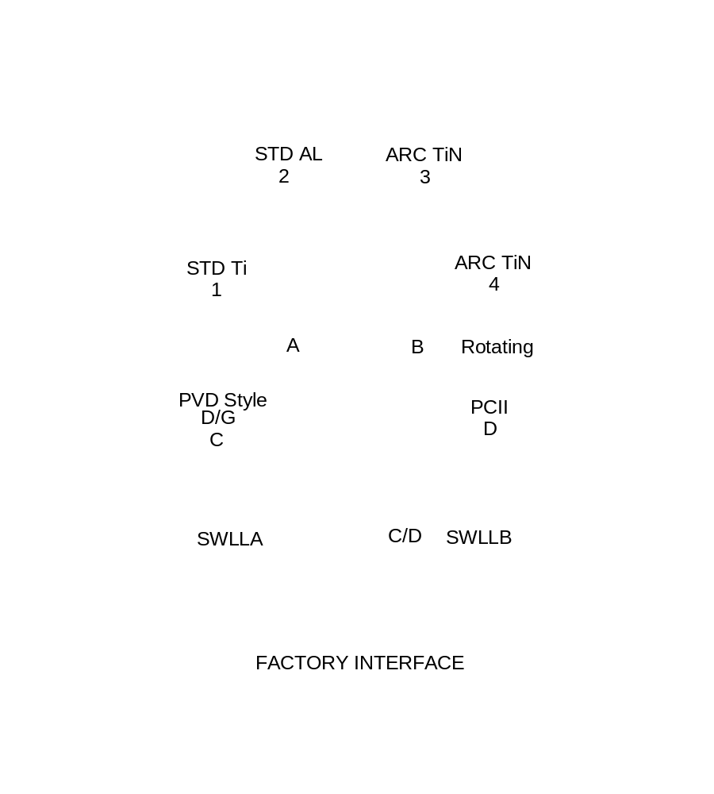
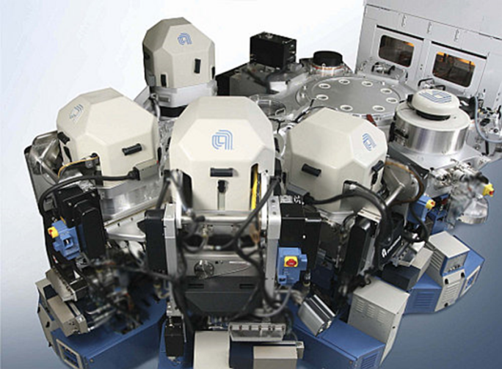
Endura® SL System Layout

Slide 24
控制系統需要控制讀取的元件
Turbo Pump
Ion Pump/TSP
Primary Pump
Hi /Low Vacuum Gauges
Sensors ( Position, Temperature….)
……..

Slide 25
軟體
Window,UNIX,DOS, LABVIEW…
AHA 採 PLC +HMI
AMAT/ Varian Implanter/ R&D
小型系統/遠端監控/Cost Saving

Slide 26
AHA 五合一真空系統控制器
Ion pump
Turbo Pump
Roughing Pump
Vacuum Gauges
Valve Control
Other Control( Heater on/off, Power on/off)

